Slide 1
Real-Time 3D Rendering with DirectX: The Essentials
Yuriy Sernivka
Lviv, Blackthorn Vision Meetup
May 29, 2018

Slide 2
What is DirectX?
DirectX is a set of low-level API's made for creating high-performance Multimedia Applications and Games. DirectX is composed of multiple APIs:
Direct3D (D3D): for drawing 3D graphics.
DXGI: for enumerating adapters and monitors and managing swap chains for Direct3D 10 and up.
Direct2D: for 2D graphics.
DirectWrite: for fonts.
DirectCompute: for GPU Computing.
DirectX Diagnostics (DxDiag): a tool for diagnosing and generating reports on components related to DirectX, such as audio, video, and input drivers.
DirectX Media Objects: support for streaming objects such as encoders, decoders, and effects.
DirectSetup: for the installation of DirectX components, and the detection of the current DirectX version.
XACT3 higher-level audio API.
XAudio2: low-level API for audio.
Notes:
DirectX - це набір низькорівневого API (Application programming interface) для створення високопродуктивних мультимедіа аплікацій та ігор.
Поділяється на такі компоненти як
Direct3D - використовується для 3D рендерінгу, підсилюючись акселерацією графічного адаптера. Цей компонент є найбільш вживаним у порівнянні з попередніми. Вся подальша розмова буде присвячена саме йому.

Slide 3




Versions of DirectX
(popular nowadays)
DirectX 9 probably has the longest running history of usage amongst all the DirectX APIs. It was popularly used from 2002 all the way into 2011 when people started to finally migrate to DirectX 11.
DirectX 10 was previously the best modern graphics API to learn 3D graphics programming with. Its only disadvantage today is that it doesn’t support hardware tessellation, however that is a minor issue.
DirectX 11 is the leading industry standard graphics API. Even alongside DirectX 12 Microsoft released DirectX 11.3 at the same time knowing that the vast majority of people writing graphics engines would not have a requirement for such low level control that DirectX 12 provides.
DirectX 12 is an expert’s API. It was written solely for developers who had already mastered DirectX 11 who require even more low level control of the rendering pipeline due to increased performance requirements
Notes:
DirectX 9
це версія відзначається найдовшим періодом використовувалася і широко використовується і сьогодні.
реліз відбувся ще у 2002
DirectX 10
наразі це попередня найпопулярніша версія

Slide 4
Graphics Core In Microsoft Windows
Microsoft- written code
IHV- written code
WPF
DWM
GDI+
Media Foundation
PIX
WIC
MIL
OpenGL ICD
GDI
D3D <9
DX VA
D3D9
D3D9 Ex
D3D 10/11
DXGI
OpenGL
User-mode driver
Common pipeline (DDI)
User mode
Kernel mode
Kernel-mode driver
Win32 Kernel
DXG Kernel
Notes:
GDI / GDI+ (Graphics Device Interface): API for representing graphical objects in Windows
Media Foundation is a COM-based (Component Object Model) multimedia framework pipeline and infrastructure platform for digital media in Windows Vista, Windows 7, Windows 8, Windows 8.1 and Windows 10. It is the intended replacement for Microsoft DirectShow, Windows Media SDK and all other so-called "legacy" multimedia APIs.
PIX Direct3D9 Graphics Profiller. Will show it in use later.
WIC (Windows Imaging Component) is a COM-based imaging codec framework introduced in Windows Vista. Allows applications supporting the framework to automatically get support of installed codecs for graphics file formats.
MIL (Media Integration Layer) interfaces directly with DirectX and provides basic support for 2D and 3D surfaces. Used by WPF and DWM.
DWM (Desktop Window Manager) is the window manager in Windows Vista, Windows 7, Windows 8 and Windows 10 that enables the use of hardware acceleration to render the graphical user interface of Windows.
WPF (Windows Presentation Foundation) is a graphical subsystem by Microsoft for rendering user interfaces in Windows-based applications.
Kernel mode vs. user mode
Device drivers, particularly on modern Microsoft Windows platforms, can run in kernel-mode or in user-mode. The primary benefit of running a driver in user mode is improved stability, since a poorly written user mode device driver cannot crash the system by overwriting kernel memory.

Slide 5
GDI And GDI+
Microsoft- written code
IHV- written code
WPF
DWM
GDI+
Media Foundation
PIX
WIC
MIL
OpenGL ICD
GDI
D3D <9
DX VA
D3D9
D3D9 Ex
D3D 10/11
DXGI
OpenGL
User-mode driver
Common pipeline (DDI)
User mode
Kernel mode
Kernel-mode driver
Win32 Kernel
DXG Kernel
Notes:
GDI (Graphics Device Interface): is a Windows API and core operating system component responsible for representing graphical objects and transmitting them to output devices such as monitors and printers.
drawing lines and curves
rendering fonts
handling palettes
GDI+
Introduced with Windows XP
anti-aliased 2D graphics
gradient shading
more complex path management
intrinsic support for modern graphics-file formats like JPEG and PNG
Win32 Kernel is a Win32 platform implementation of WinAPI
DXG Kernel no information on the web except blue screen errors

Slide 6
Windows Presentation Foundation
Microsoft- written code
IHV- written code
WPF
DWM
GDI+
Media Foundation
PIX
WIC
MIL
OpenGL ICD
GDI
D3D <9
DX VA
D3D9
D3D9 Ex
D3D 10/11
DXGI
OpenGL
User-mode driver
Common pipeline (DDI)
User mode
Kernel mode
Kernel-mode driver
Win32 Kernel
DXG Kernel
Notes:
WPF is a graphical subsystem by Microsoft for rendering user interfaces in Windows-based applications.
Graphics, including desktop items like windows, are rendered using Direct3D. This allows the display of more complex graphics and custom themes. It allows Windows to offload some graphics tasks to the GPU. This reduces the workload on the computer's CPU.
DDI (Device Driver Interface) provides a software interface to hardware devices, enabling operating systems and other computer programs to access hardware functions without needing to know precise details about the hardware being used.
DXVA (DirectX Video Acceleration) is a API specification for the Windows and Xbox platforms that allows video decoding to be hardware accelerated.

Slide 7
Direct3D Graphics Pipeline
Vertex
Data
Tessellation
Vertex
Processing
Geometry
Processing
Pixel
Processing
Pixel
Rendering
Texture Sampler
Direct3D 9
Direct3D 11
Input-Assembler
Stage
Vertex Shader
Stage
Hull Shader
Stage
Tesselator
Stage
Domain Shader
Stage
Geometry
Shader
Stage
Rasterizer
Stage
Vertex Shader
Stage
Rasterizer
Stage
Stream
Output
Stage
Notes:
The graphics pipeline provides the horsepower to efficiently process and render Direct3D scenes to a display, taking advantage of available hardware. The following diagram shows the building blocks of the pipeline:
{img}
Vertex Data: Untransformed model vertices are stored in vertex memory buffers
Tessellation: The tesselator unit converts higher-order primitives, displacement maps, and mesh patches to vertex locations and stores those locations in vertex buffers.
Vertex Processing: Direct3D transformations are applied to vertices stored in the vertex buffer.
Geometry Processing: Clipping, back face culling, attribute evaluation, and rasterization are applied to the transformed vertices.
Textured Surface: Texture coordinates for Direct3D surfaces are supplied to Direct3D through the IDirect3DTexture9 interface.
Texture Sampler: Texture level-of-detail filtering is applied to input texture values.
Pixel Processing: Pixel shader operations use geometry data to modify input vertex and texture data, yielding output pixel color values.
Pixel Rendering: Final rendering processes modify pixel color values with alpha, depth, or stencil testing, or by applying alpha blending or fog. All resulting pixel values are presented to the output display.

Slide 8
D3D9 vs D3D11: Similarity
Vertex
Data
Tessellation
Vertex
Processing
Geometry
Processing
Pixel
Processing
Pixel
Rendering
Texture Sampler
Direct3D 9
Direct3D 11
Input
Assembler
Stage
Vertex Shader
Stage
Hull Shader
Stage
Tesselator
Stage
Domain Shader
Stage
Geometry
Shader
Stage
Rasterizer
Stage
Pixel
Shader
Stage
Output
Merger
Stage
Stream
Output
Stage
Notes:
The graphics pipeline provides the horsepower to efficiently process and render Direct3D scenes to a display, taking advantage of available hardware. The following diagram shows the building blocks of the pipeline:
{img}
Vertex Data: Untransformed model vertices are stored in vertex memory buffers
Tessellation: The tesselator unit converts higher-order primitives, displacement maps, and mesh patches to vertex locations and stores those locations in vertex buffers.
Vertex Processing: Direct3D transformations are applied to vertices stored in the vertex buffer.
Geometry Processing: Clipping, back face culling, attribute evaluation, and rasterization are applied to the transformed vertices.
Textured Surface: Texture coordinates for Direct3D surfaces are supplied to Direct3D through the IDirect3DTexture9 interface.
Texture Sampler: Texture level-of-detail filtering is applied to input texture values.
Pixel Processing: Pixel shader operations use geometry data to modify input vertex and texture data, yielding output pixel color values.
Pixel Rendering: Final rendering processes modify pixel color values with alpha, depth, or stencil testing, or by applying alpha blending or fog. All resulting pixel values are presented to the output display.

Slide 9


Slide 10
E1: Typical skeleton of any
Win32 Game
Based on WinAPI messages
Infinite loop: until user requested to quit
Frame rendering is synchronized with Application Idle state
User input (keyboard, mouse, gamepad) is usually processed by DirectInput but not by corresponding WinAPI messages
Notes:
{Example1_Win32_Window}
Application entrypoint {WndProc: 19}
Creating and showing the window {InitializeWindow: 43}
Infinite loop {messageloop: 101}
WndProc {WndProc: 131}

Slide 11
E2: Initializing of Direct3D
Creating Direct3D9 and Direct3DDevice9 COM objects
Calculating time span between current and next frames (used for animation)
Do rendering (actually just clearing the buffer with some color)
Notes:
[Vertex Data]
{Example2_Initializing_Direct3D}
Declaring pointers to IDirect3D9 and IDirect3DDevice9 {16, 19}
New in WinMain: InitializeD3DWindow, SetupScene, RenderScene (DI), CleanUpScene {77}
Creating Direct3D9 object and getting hardware capabilities {175}
Filling D3DPRESENT_PARAMETERS {196}
Creating Direct3DDevice9 object {242}
SetupScene / CleanUpScene are empty {45}
Frame rendering in messageloop {300}
RenderScene {55}

Slide 12
Vertex Data
In geometry, a vertex is a point where two or more curves, lines, or edges meet.
Vertex Rendering is the process of taking vertex data specified in arrays and rendering one or more Primitives with this vertex data.
VD
Tess
VP
GP
PP
PR
TS
Notes:
Example image on next page!

Slide 13
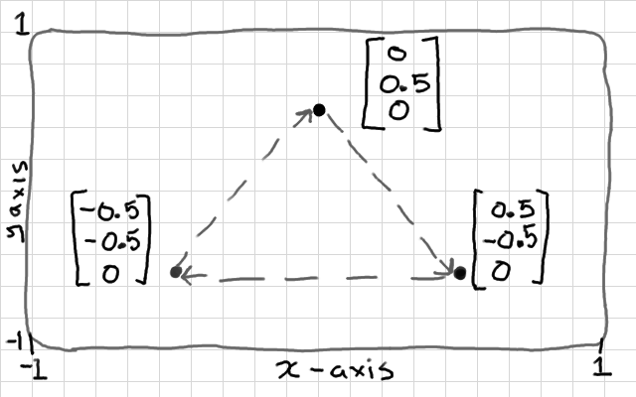
Vertex Data

Slide 14
E3: Rendering the quad
Vertex Rendering is the process of taking vertex data specified in arrays and rendering one or more Primitives with this vertex data.
VD
Tess
VP
GP
PP
PR
TS
Notes:
[Vertex Data]
{Example3_StartDrawing}
Define vertex data structure in application code {35}
Create IDirect3DVertexBuffer9 {58}
Render {100}
Don’t forget to release DX resources {152}

Slide 15
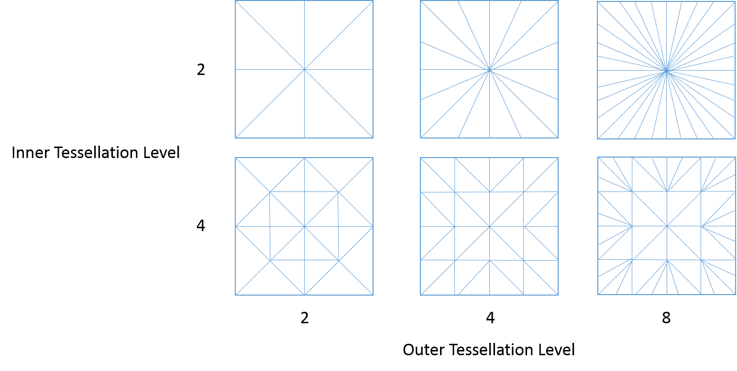
Tessellation
As a concept, tessellation is fairly straight forward - you take a polygon and dice it into smaller pieces.

Slide 16
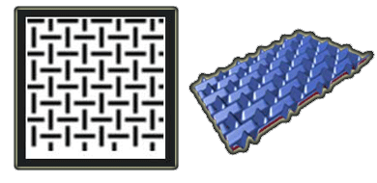
Displacement Mapping
When a displacement map (left) is applied to a flat surface, the resulting surface (right) expresses the height information encoded in the displacement map.

Slide 17
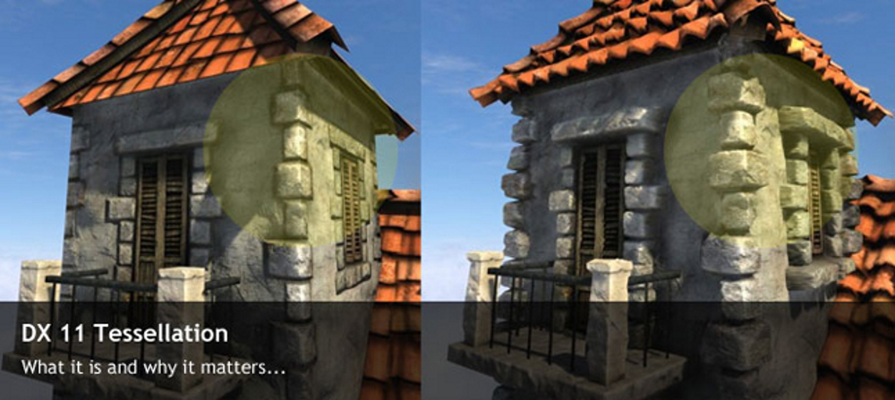
Tessellation + Displacement Mapping

Slide 18
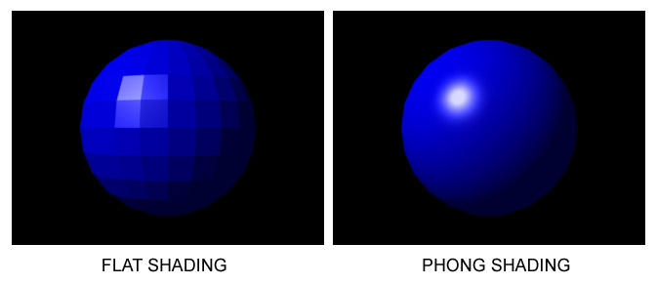
E4: Vertex Processing
Fixed Functions Pipeline
Vertex Shader (HLSL)
VD
Tess
VP
GP
PP
PR
TS
Notes:
Fixed-function is a term canonically used to contrast 3D graphics APIs and earlier GPUs designed prior to the advent of shader-based 3D graphics APIs and GPU architectures.
In computer graphics, a shader is a type of computer program that was originally used for shading (the production of appropriate levels of light, darkness, and color within an image) but which now performs a variety of specialized functions in various fields of computer graphics special effects or does video post-processing unrelated to shading, or even functions unrelated to graphics at all.
Phong shading refers to an interpolation technique for surface shading in 3D computer graphics.
{Example4_Shaders}
Declare Vertex Shader object, Vertex Declaration and Constant Table {25}
Create Vertex Declaration object {95}
Compile Vertex Shader to bytecode {108}
Create Vertex Shader object {112}
Vertex Shader File {VertexShader.h}

Slide 19
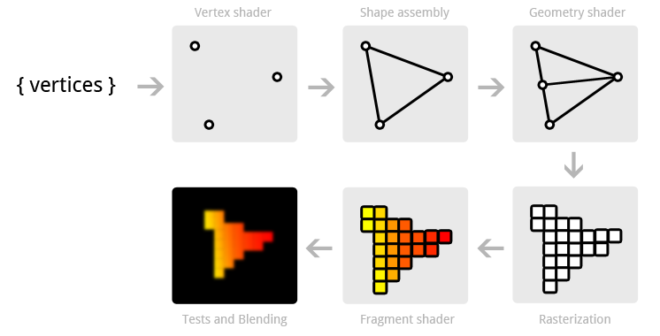
E5: Geometry Processing
VD
Tess
VP
GP
PP
PR
TS
Notes:
{Example5_ZBuffer}
Setup constants for first quad {main.cpp: 126}
Render first quad {main.cpp: 140}
Setup constants for second quad {main.cpp: 144}
Render second quad {main.cpp: 151}
Compile Vertex Shader to bytecode {108}
Create Vertex Shader object {112}

Slide 20
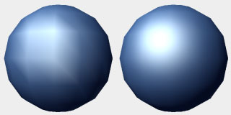
E6: Pixel Processing
Pixel Shader
Vertex Shading vs Pixel Shading
VD
Tess
VP
GP
PP
PR
TS
Notes:
{Example6_PixelShader}
Declare Pixel Shader variable {main.cpp: 26}
Compile and Create Pixel Shader {main.cpp: 116}
Set it to device during rendering {main.cpp: 144}
Render second quad {main.cpp: 151}
{VertexShader.h}
{PixelShader.h}

Slide 21
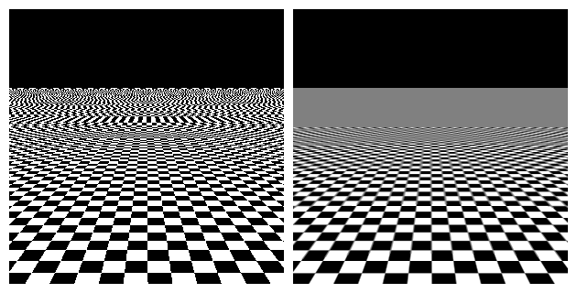
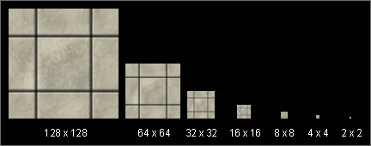
E7: Texture Sampler
Load Texture (Image) from disk
Sampler, Mip Maps
VD
Tess
VP
GP
PP
PR
TS
Notes:
{Example7_Texture}
UV in Vertex structure {main.cpp: 40}
Setup UV {main.cpp: 81}
Update Vertex Declaration {main.cpp: 107}
Load texture {main.cpp: 135}
Setup sampler {main.cpp: 158}
{VertexShader.h}
{PixelShader.h}

Slide 22
E8: Pixel Rendering
Load Texture (Image) from disk
Sampler, Mip Maps
VD
Tess
VP
GP
PP
PR
TS
Notes:
{Example8_AlphaBlend}
Setup Alpha Blending {main.cpp: 169}
{PixelShader.h}

Slide 23
And the last example...

